Slide 1
Wine Price Classification
Trey Hannam

Slide 2
Goal
The aim of this project was to build a model to classify how expensive a bottle of wine is.
The classifications are: - cheap - below average - average - above average - expensive

Slide 3
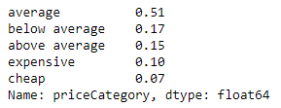
Data
The data used for this project is located on kaggle. The data is from the website Wine Enthusiast and was scrapped in November, 2017.
Price - removed null values ~ 8k out of 130K - distribution of encoded price

Slide 4
Data Continued
Null Values: - There were some categorical variables that had null values. - filled in with unknown
Data Prep: - before modeling, all the categorical variables were encoded numerically

Slide 5
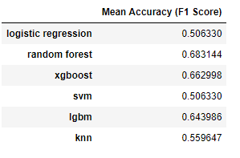
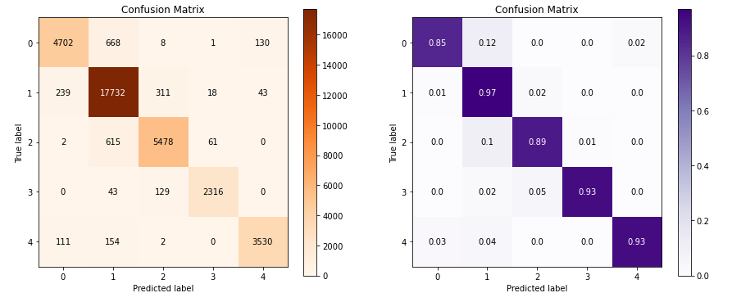
Model Selection and Performance
When selecting a model I decided to go off the F1 score, ultimately xgboost was selected. With hypertuning I was able to improve the F1 score of the model by ~ 10%
*confusion matrix for tuned model

Slide 6
Future Considerations
This project was focused on learning outcomes rather than practicing for real world applications.
To make this project a real world application I would suggest a recommendation system for Wine Enthusiast website users.

Slide 7
Conclusion
The goal was to be able to categorize the price of wine given related information about the wine. The intention was to build a model that would classify wine prices in a mannar where consumers can determine the relative pricing (expensive vs average) given the information they know about the wine.

Slide 8
Questions

